Slide 1
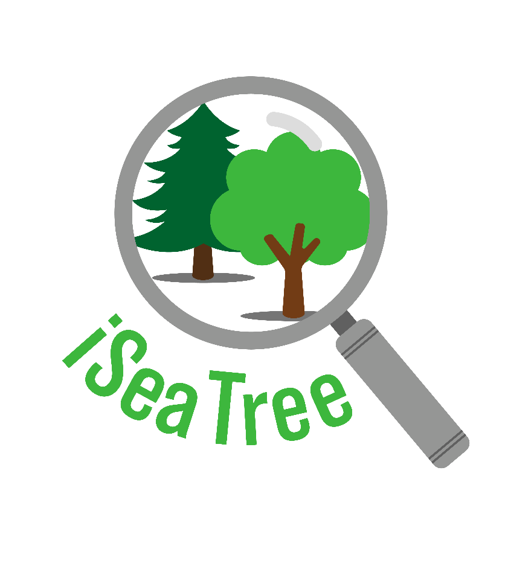
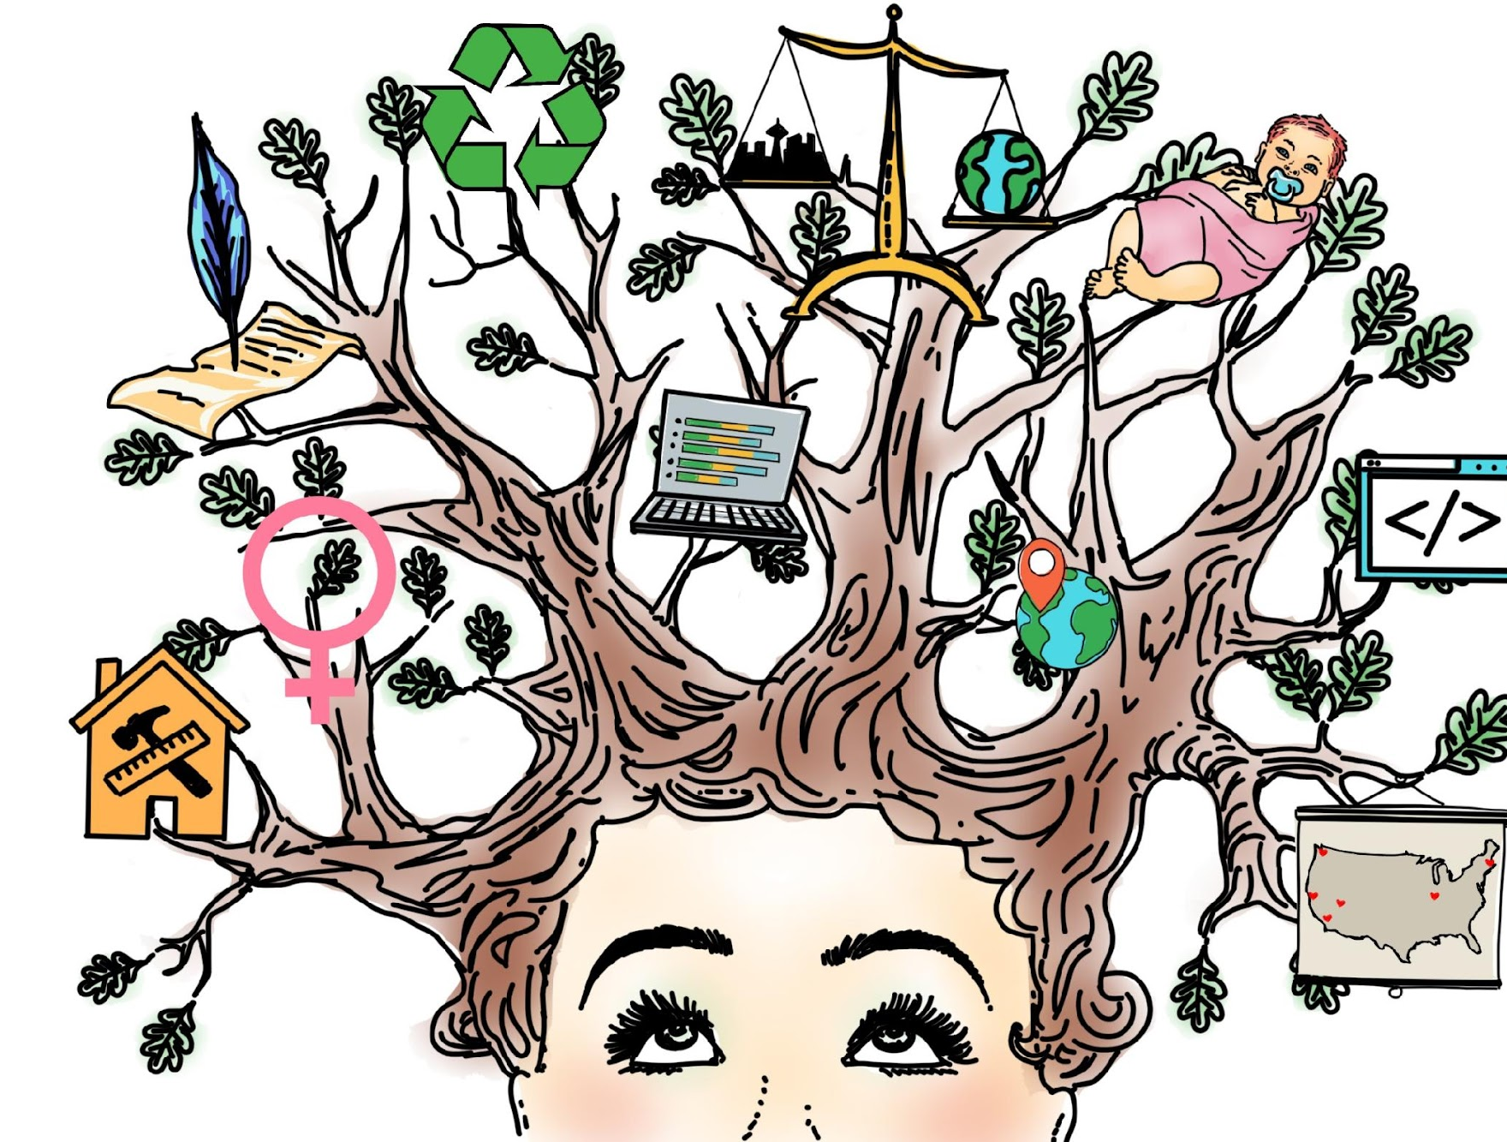
iSeaTree
TreeMama.org / Democracy Lab
Notes:
Run by TreeMama.org. Sponsored by Democracy Lab

Slide 2

Notes:
1:20

Slide 3
Getting Started…
Field teams surveying trees had been:
Taking paper notes,
Recording information in spreadsheets, asnd returning to the office to later run it through the iTree API.
We asked: Why not just build an app to input the data in the field?
How can we more effectively get more data into the database? (Geared toward school children)
COVID - The idea of a mobile application that got kids away from their kitchen tables was well received.

Slide 4
Planning
USER PERSONAS:
What motivates people
students: to learn about the environment
teachers: to adopt the platform
Wants
Pain points
lack of financial resources
different eco systems
Technology available at the student level
Technology available in the world
Go open source (free, flexible, build a community)
iNaturalist
The Darwin Survival Game
Kahoot

Slide 5
Roadmap
Basic data collection processing tested and working
Simple game rules in place: ‘ID Levels’, ‘number of trees’
Map validation page and process were completed
V1 public release
Public code release on Github
V1 (MVP)
July 2020
2021
2022
2023
Notes:
Can;t work with youth because of pandemic: V1: Bare bones (open source). Committed to the idea of working with open source ecosystem. V2: Made available in USA and Canada for ITree API: US Forest service API. Input the data into the API in the field. Limitations: didn't work with Jest for testing. We need an AR framework to measure the trees. Complete overhaul and used React Native instread of Expo
V2.1 - 2.3 Make it more accessible: add graphics, etc. for IUD. had used a dichotomous key system…. Is it a conifer or a broadleaf? (info page) Get deeper (cone type, which way does it point, etc. So we can filter out trees and gain specificity. Camera DBH Tool: democaracy Lab skills were in UX and UI. How do users interact with the app? Stay true to the mission of being accessible to children. AR can only be used on certain platforms, so not all kids may have the proper tech. (inclusivity)
V4: Carnegie Melon students came in CMU to develop the platform further: biggest is the AI function ( bcalls a second API (Plant Aid) ID at species/genus, info menu was retooled and allowed users the ability to filter by confirer, broadleaf, needle type…
Noiw we're working to improve data analytics and data visualization.

Slide 6
Roadmap
Added in-app map validation
Added iTree API
Made app available in
USA and Canada
Removed expo-cli and became a purely react-native application (some legacy expo dependencies handled with
‘react-native-unimodules’)
V1 (MVP)
V2
Basic Data Collection Processing Tested and Working
Simple Game rules in place: ‘ID Levels’, ‘Number of Trees’
Map Validation Page and Process are complete \
V1 Public Release \
Public Code Release on Github
July 2020
2021
2022
2023
Notes:
Can;t work with youth because of pandemic: V1: Bare bones (open source). Committed to the idea of working with open source ecosystem. V2: Made available in USA and Canada for ITree API: US Forest service API. Input the data into the API in the field. Limitations: didn't work with Jest for testing. We need an AR framework to measure the trees. Complete overhaul and used React Native instread of Expo
V2.1 - 2.3 Make it more accessible: add graphics, etc. for IUD. had used a dichotomous key system…. Is it a conifer or a broadleaf? (info page) Get deeper (cone type, which way does it point, etc. So we can filter out trees and gain specificity. Camera DBH Tool: democaracy Lab skills were in UX and UI. How do users interact with the app? Stay true to the mission of being accessible to children. AR can only be used on certain platforms, so not all kids may have the proper tech. (inclusivity)
V4: Carnegie Melon students came in CMU to develop the platform further: biggest is the AI function ( bcalls a second API (Plant Aid) ID at species/genus, info menu was retooled and allowed users the ability to filter by confirer, broadleaf, needle type…
Noiw we're working to improve data analytics and data visualization.
AI: Uses Plant.id API which uses Deep Convoluted Neural Networks to attempt to identify a tree. Location is one of the variables that we have to give it to improve its accuracy. It tries to decide the likelihood of a tree existing in a certain place.

Slide 7
Roadmap
Added tree pictures. Start populating a Tree Identification Schema for 300+ trees
DBH measuring tool
Front-end UX/UI refinement (profile page improvements)
Jest test framework
V1 (MVP)
V2
V2.1- V3
Basic Data Collection Processing Tested and Working
Simple Game rules in place: ‘ID Levels’, ‘Number of Trees’
Map Validation Page and Process are complete \
V1 Public Release \
Public Code Release on Git
Added in-App Map Validation
Added iTree API
Made app available in
USA and Canada
Removed expo-cli and became a purely react-native application (some legacy expo dependencies handled with
‘react-native-unimodules’)
July 2020
2021
2022
2023
Notes:
Can;t work with youth because of pandemic: V1: Bare bones (open source). Committed to the idea of working with open source ecosystem. V2: Made available in USA and Canada for ITree API: US Forest service API. Input the data into the API in the field. Limitations: didn't work with Jest for testing. We need an AR framework to measure the trees. Complete overhaul and used React Native instread of Expo
V2.1 - 2.3 Make it more accessible: add graphics, etc. for IUD. had used a dichotomous key system…. Is it a conifer or a broadleaf? (info page) Get deeper (cone type, which way does it point, etc. So we can filter out trees and gain specificity. Camera DBH Tool: democaracy Lab skills were in UX and UI. How do users interact with the app? Stay true to the mission of being accessible to children. AR can only be used on certain platforms, so not all kids may have the proper tech. (inclusivity)
V4: Carnegie Melon students came in CMU to develop the platform further: biggest is the AI function ( bcalls a second API (Plant Aid) ID at species/genus, info menu was retooled and allowed users the ability to filter by confirer, broadleaf, needle type…
Noiw we're working to improve data analytics and data visualization.

Slide 8
Roadmap
V1 (MVP)
V2
V2.1-3
Basic Data Collection Processing Tested and Working
Simple Game rules in place: ‘ID Levels’, ‘Number of Trees’
Map Validation Page and Process are complete \
V1 Public Release \
Public Code Release on Git
V4
Added in-App Map Validation
Added iTree API
Made app available in
USA and Canada
Removed expo-cli and became a purely react-native application (some legacy expo dependencies handled with
‘react-native-unimodules’)
Added tree pictures. Start populating a Tree Identification Schema for 300+ trees
AR-DBH measuring tool
Front-end UX/UI refinement (profile page improvements)
Jest Test Framework
Added AI (TreeBot/ Plant.id)
Added graphical info menu with filtering options utilizing the ‘Tree Identification Schema’
Improved Data Analytics
+100 trees (total ~400)
July 2020
2021
2022
2023
Notes:
Can;t work with youth because of pandemic: V1: Bare bones (open source). Committed to the idea of working with open source ecosystem. V2: Made available in USA and Canada for ITree API: US Forest service API. Input the data into the API in the field. Limitations: didn't work with Jest for testing. We need an AR framework to measure the trees. Complete overhaul and used React Native instread of Expo
iTree: calculates the benefits
AI: Using a Deep Neural Network to
V2.1 - 2.3 Make it more accessible: add graphics, etc. for IUD. had used a dichotomous key system…. Is it a conifer or a broadleaf? (info page) Get deeper (cone type, which way does it point, etc. So we can filter out trees and gain specificity. Camera DBH Tool: democaracy Lab skills were in UX and UI. How do users interact with the app? Stay true to the mission of being accessible to children. AR can only be used on certain platforms, so not all kids may have the proper tech. (inclusivity)
V4: Carnegie Melon students came in CMU to develop the platform further: biggest is the AI function ( bcalls a second API (Plant Aid) ID at species/genus, info menu was retooled and allowed users the ability to filter by confirer, broadleaf, needle type…
Noiw we're working to improve data analytics and data visualization.

Slide 9
iTreeAPI:
Used by USFS / Davey Trees / City of Seattle and other professional arborists.
Designed by mathematicians and arborists, not geo-professionals
It’s purpose: Calculate the tree's CO2/H2O/air pollution benefits
Location:
Why iSeaTree is a mobile App, using geolocation to pinpoint the tree.
Initially geolocation had to be city+county+state to get an API response, and now it's lat+lon.
We initially had to reverse-geocode.
DBH
Species
Tree Condition
Tree Light Exposure

Slide 10
MyTree vs. iSeaTree
MyTree
MyTree is a Progressive Web App that accesses the iTree API to calculate the tree benefits
Anyone with a browser can access it (mobile or desktop)
Easier to maintain
Cheaper
Does not store data, it only calculates Tree Benefits
Does not contribute to open data
Expert level only
iSeaTree
Native App that accesses the iTree API to calculate the tree benefits
Mobile-only (not as easy to access as a PWA - you have to download it)
Harder to maintain ( we need to comply with the app stores)
More expensive
Labor and API costs (we are committed to being open source and trying to use open source resources to reduce costs)
PlantID API
Stores the data
We are an open data platform
Beginner-level to expert-level
Builds community

Slide 11
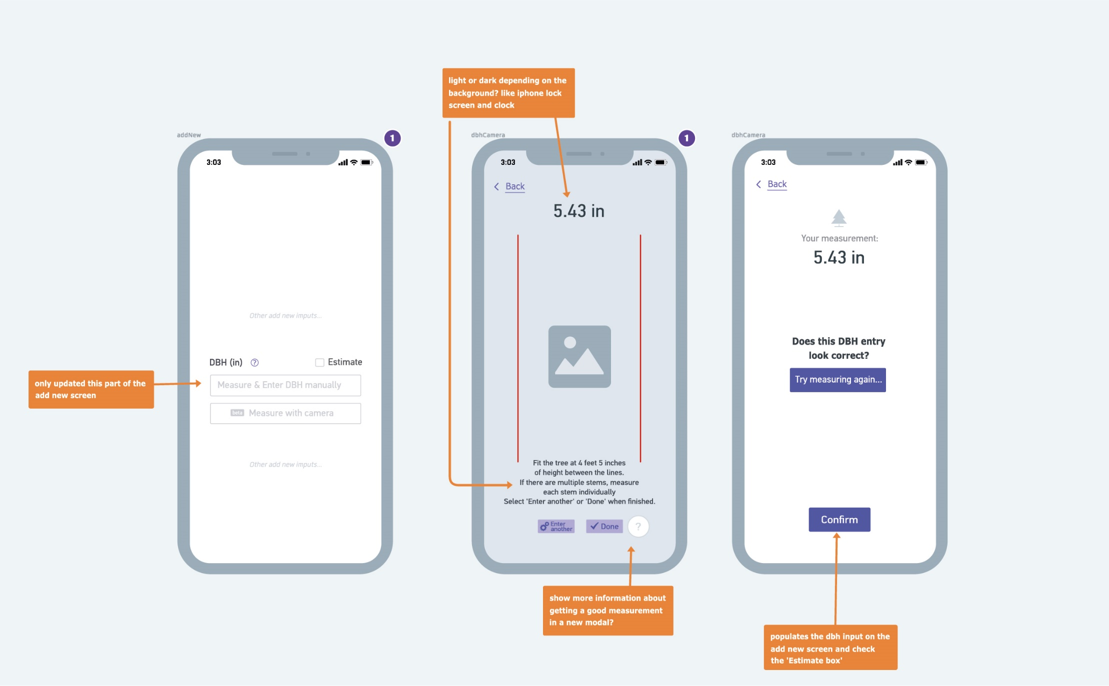
Camera DBH tool mockup. Beta Version released in V2+.
Notes:
Added Camera DBH tool. line up, click a button, get a number, enter it in. Steered away from AR and use a trigonometric function. Accuracy could be improved.

Slide 12
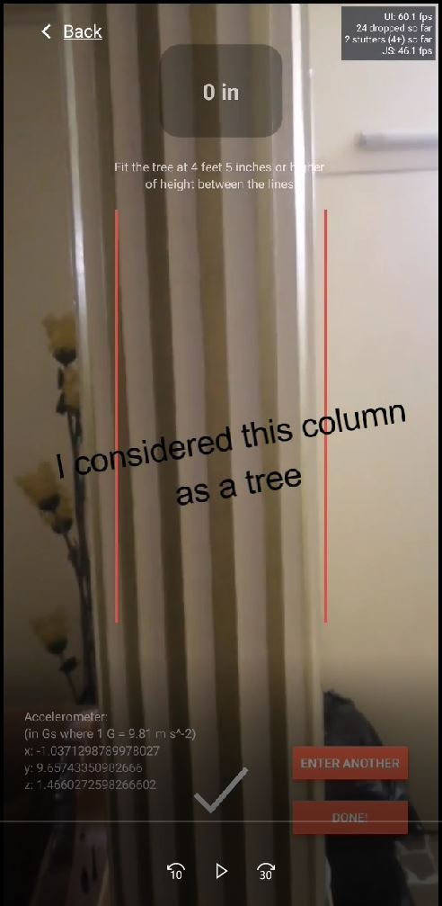
DBH tool: - Originally was going to do AR/LiDAR - However, concerns about equity and device capabilities led us to move forward with a trig solution (using the phone’s accelerometer).
Notes:
Video is an example of a user using it in the field. We measured 28, she got 29. Good enough.

Slide 13
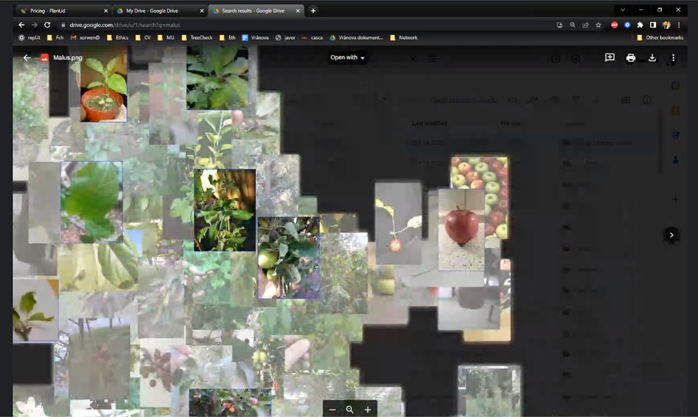
Plant ID's segmentation analysis of an apple tree
Notes:
Looking for things that are part of the tree: leaves, fruit, cones, bark, etc. Anything that is noise will be removed.
The AI uses location as well to help make better decisions (i.e., is that palm tree really in Seattle?).

Slide 14
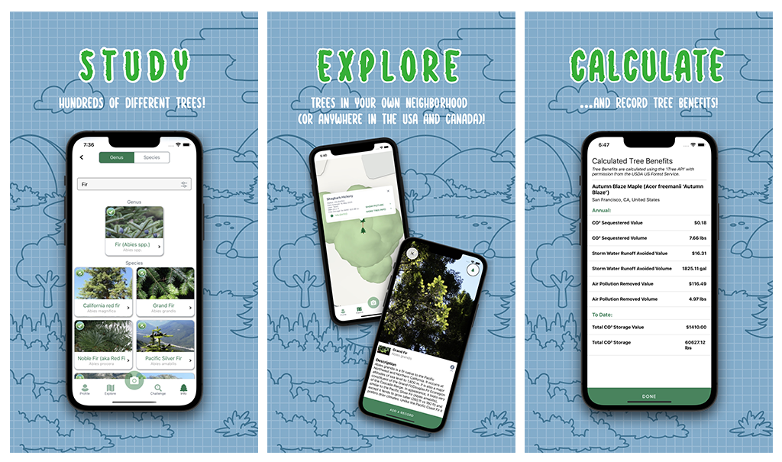

Slide 15
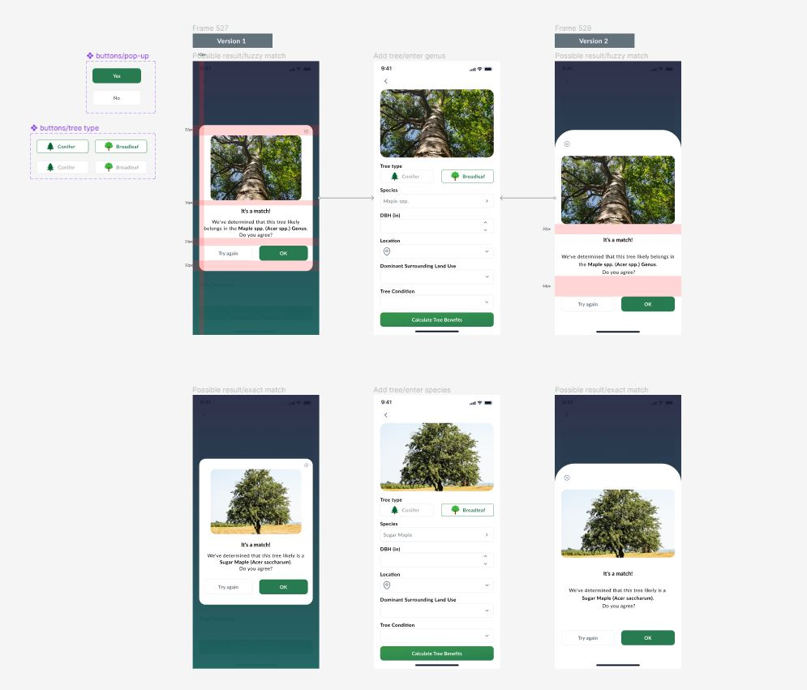
Get Involved!
Quarterly Hackathons (Democracy Lab)
Earthathon 4/22 (Earth Day)
Download the app (iOS & Android)
https://treemama.org/the-tech-treehouse/iseatree
Volunteer (Democracy Lab)
Engineers
UI/UX
Writers
Data Visualization
User Testers!!!
Follow us on Twitter
@TreeMamaSEA

Slide 16
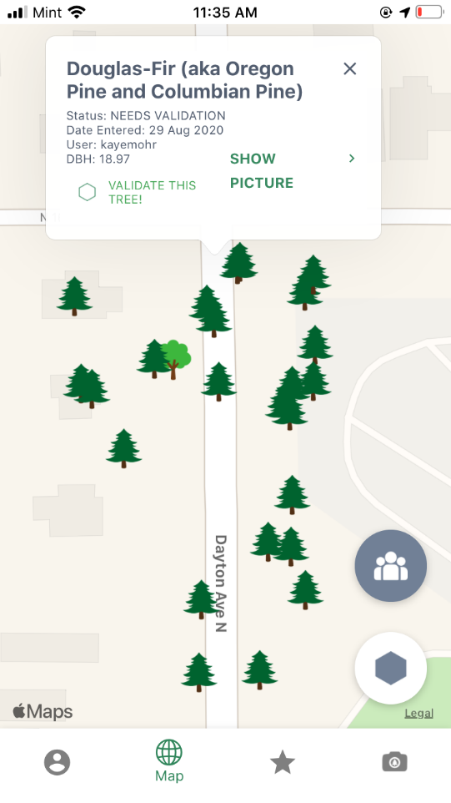
THANK YOU iSEATREE VOLUNTEERS!
QUESTIONS?
Stephen Clemmer, Seattle, WA
stephenjclemmer@gmail.com
https://www.linkedin.com/in/stephen-clemmer
Notes:
jump on our slack or twitter.

Slide 17
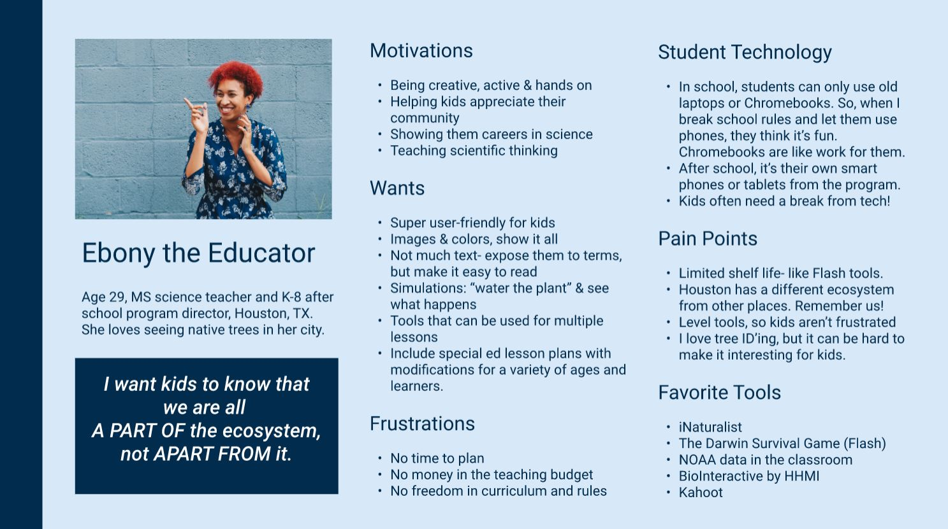
Understanding our target user base (Thank you Siobhan!)
Notes:
Check name of the persona. Does Ebony have a Last initial?

Slide 18
Notes
Urban trees esp important: Not a well understood resource. Valuable in the following ways: … Invasive species: Bradford Pear, Ginko? How do matters like climate change and invasive species need to be accounted for?
The findings — that old trees not only store carbon and prevent it from escaping into the atmosphere, but actively covert CO2 in the air into their trunks, branches and leaves — make an important case for the preservation of the country’s old-growth forests.
Going into the future, “we are going to want to manage some forests for carbon sequestration; to do that, you’ve really got to know which trees are your star players,” Stephenson said. In this case, the star players on the team are not the young 20-year-olds, but the 90-year-olds, he added.
AI: Uses Plant.id API which uses Deep Convoluted Neural Networks to attempt to identify a tree. Location is one of the variables that we have to give it to improve its accuracy. It tries to decide the likelihood of a tree existing in a certain place. ultimately, we're just calling the API, and our data is being use dto help make it more accurate.
We have a sytake inrecording what things are actually worth.
MyTree is a Progressive Web App (Browser-based technology). So anyone with a browser can access it. Not yet as good as the native code iTpree API is massive: supported by US forest Service and the Davvy Tree Service. Has limitations….
ID
Pictures
Validation System
Tryinbg to use an AI function to learn what is and is not a tree. Use AR-like tool to get the DBH. Decided to build a native app for these reasons. Maps and Spatial tech - Oak in Seattle sequesters a different amount of carbon and water that an oak elsewhere. DBH: diameter of breast height. Species. Condition: healthy r dying? Light exposure: what's happening above the tree's canpopy. 5 factors calculate the tree benefits.

